Slide 1

ZOMATO RESTAURANTS ANALYSIS
Ekansh Agnihotri
24/05/2014

Slide 2

About Zomato
Zomato is a popular online platform that provides information about restaurants, including location, ratings, reviews, menus, and photos.
It operates in multiple countries and has a vast database of restaurants, making it a valuable resource for diners and restaurant owners alike.

Slide 3
01
02
03
04
How Zomato Works?
05
Users can explore various restaurants & order meals from the desiccated appsolution or website.
Particular restaurant owners receive an order request and start preparing meals.
Once the food is ready to dispatch, it will be handed over to delivery providers.
Delivery provider delivers the meal to customer’s preferred location.
Customers can make payments and share reviews based on their experience with the given payment option.

Slide 4
Project Overview
Here’s what you’ll find in this project:
The Zomato Restaurants Analysis project aims to provide a comprehensive analysis of restaurant data sourced from Zomato, a leading online platform for discovering and reviewing restaurants.
The project involves in-depth analysis of Zomato restaurant data using various tools and techniques like Excel and Dashboards.
The objective is to gain insights into restaurant industry trends related to location, opening trends, ratings, and price ranges.

Slide 5
Data Overview
1.
3.
2.
4.
This dataset allows for an in-depth understanding of Zomato’s market presence and operational scope.
The dataset consisted of 9551 restaurants across 15 countries of the world.
Restaurants are divided into 4 different categories of price range.
The data from 2010-2018 is available & divided into various cuisines.
Also, various key data like online delivery, table booking, rating & average cost for two is also available in the dataset

Slide 6


Methodology
1
Data Cleaning
3
Data Exploration
Data Preprocessing
2
4
Data Visualization
The data involved empty cells in the cuisine column due to which those rows were removed to ensure data quality.
Employed PivotTables for summarizing key metrics & developed charts and graphs to analyze restaurant data by location, ratings, price range, and cuisine.
Revived country name through country id using XLOOKUP and also separated the year from date column using LEFT function.
Dashboard and slicers are made to draw insights

Slide 7
Objective Questions
A table to represent the number of restaurants opened in each country.
Key Takeaways
This data helps in getting the number of restaurants present in each country.
Therefore, the country having less number of restaurants surely has more suitable for opening new restaurants .
Australia | 24
Brazil | 60
Canada | 4
India | 8652
Indonesia | 21
New Zealand | 40
Philippines | 22
Qatar | 20
Singapore | 20
South Africa | 60
Sri Lanka | 20
Turkey | 34
United Arab Emirates | 60
United Kingdom | 80
United States of America | 425

Slide 8
Objective Questions
Number of restaurants opened in each year.
Key Takeaways
This data helps in getting the number of restaurants opened from 2010-2018.
The data shows an irregular trend where the number of new restaurants opened dropped from 2012-2016 and then again increased in 2017, 2018.

Slide 9
Objective Questions
The average number of voters for the restaurants in each country.
Key Takeaways
This data helps in knowing the average number of voters who provided their feedback for any restaurant in each country.
It shows that countries like Indonesia, UAE, USA have higher number of people who have voted for the restaurants.

Slide 10
Subjective Questions
Number of restaurants of different price ranges in all the countries.
Key Takeaways
The chart shows the distribution of restaurants of different price range in each suggested country.
It can be analysed through chart that instead of Australia all other countries have restaurants only in the range of 2-3
Qatar & Singapore have the most no. of top rated restaurants.

Slide 11
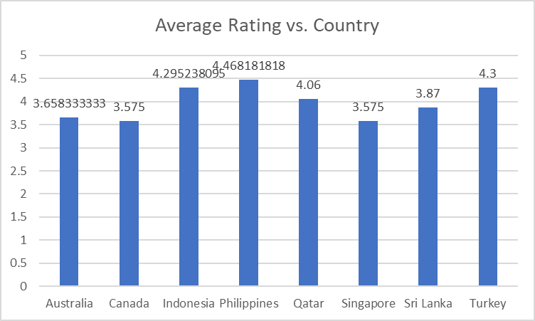
Subjective Questions
Current quality in terms of ratings for restaurants in suggested countries.
Key Takeaways
The quality of restaurants is judged through average rating of the restaurants.
It shows that Philippines has the highest average rating and Canada has the lowest average rating of restaurants in the list of suggested countries.

Slide 12
Subjective Questions
Should we go for online delivery and table booking?
Key Takeaways
The chart shows the availability of online delivery and table booking facility against the average rating.
It can be clearly seen that the restaurants having both the facilities have a better customer rating.
Thus, we should focus on starting these facilities.

Slide 13
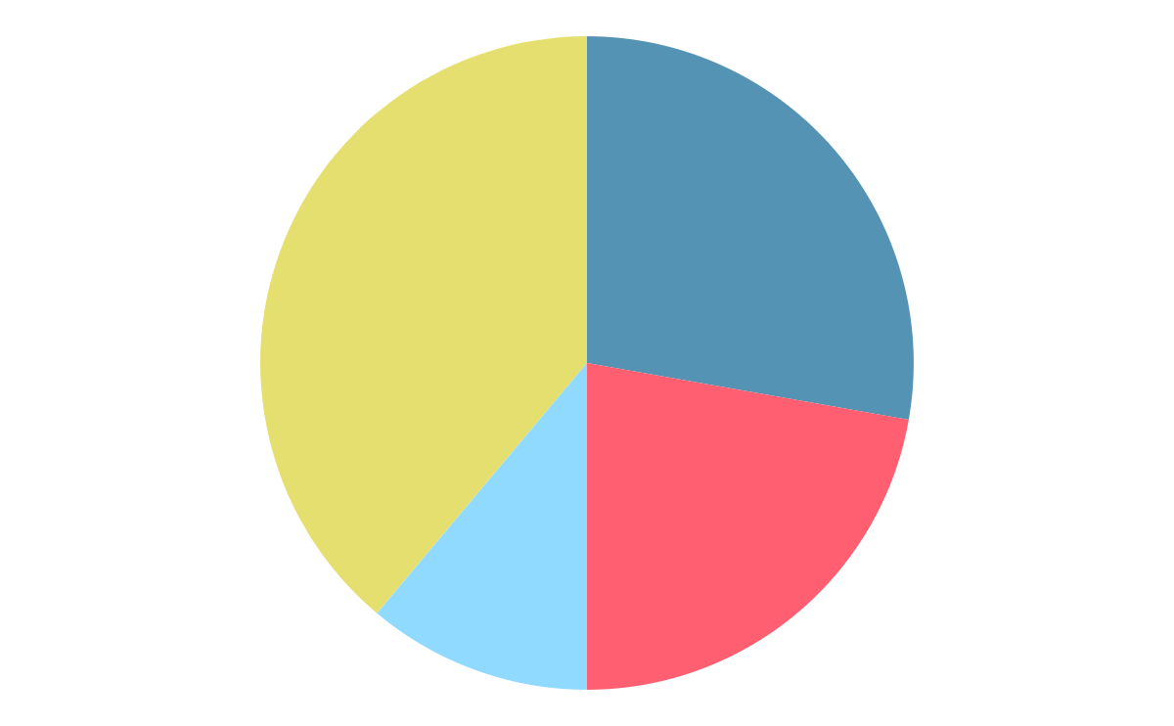
Recommendations
1.
3.
2.
4.
Restaurants should focus on providing both online delivery and table booking facility to attract more customers.
The restaurant should be opened in the suggested countries so as to have less competition.
Restaurants opened in the suggested countries should be based on price range. Countries having less number of middle price range restaurants should have such restaurants.
Each country has its top rated cuisine so new restaurants should be opened keeping this in mind.

Slide 14

Dashboard
PivotCharts
Slicers
Various PivotCharts are included in the dashboard to make it interactive and to understand the trends
Slicers are used to manipulate the data in real time and get the desired results on the charts
Charts related to countries, average rating, average cost for two, online delivery, table booking, year of opening etc are there in the dashboard
Slicers related to Country and Year of Opening help in changing the data according to our will

Slide 15
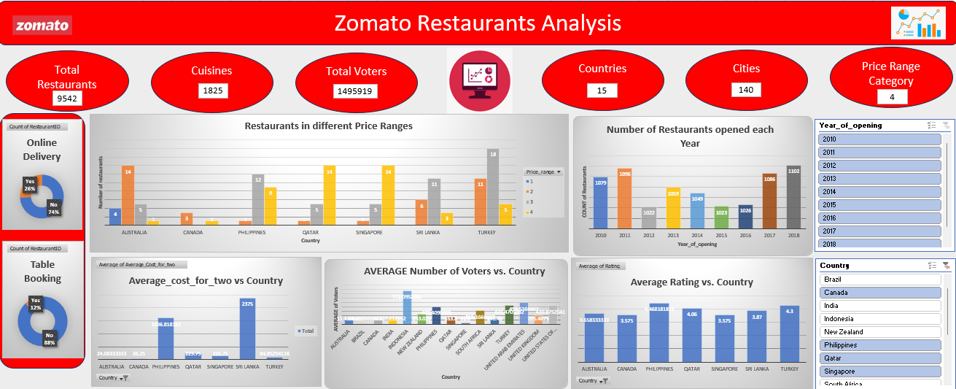

Slide 16

Smile is brightest when food is best.

Slide 17
Conclusion
Identified trends based on countries, year of opening, ratings and price range.
The restaurant should be opened bases on the suggestions related to the number of restaurants already present in a country, price range, and the average rating of other restaurants.
Including facilities like online delivery and table booking will increase the rating of the restaurant.

Slide 18

References
www.wikipedia.com
www.github.com
www.kaggle.com
www.analyticsvidya.com

